Slide 1

SOCaaS Project Vanguard Law Firm Jad Habli

Slide 2
Table of Contents
Tasks of The Project
Detection Content & Triage
01
04
Customer Profile & Security Model
SOAR & Simulation
02
05
Architecture & Onboarding
Next Steps
03
06

Slide 3
01. Tasks completed
Designed Customer Infrastructure
Defined Onboarding Plan
Created a SOC Environment
Developed Custom Detection Rules
Created L1 Triage Playbooks
Setup SOAR Workflows
Simulated Incidents

Slide 4
02.
Customer Profile: Vanguard
Industry : Law Firm
Size : 50 + Employees in Lebanon
Established Reputation & high value client base
Key Business Functions: Corporate Law & Litigation
Pain Points: Previously targeted by a ransomware incident causing reputational damage and raising compliance concerns

Slide 5
Threat Landscape & Statistics
Risks
Statistics
Ransomware
Credential Attacks
Privilege Escalation
Phishing
Insider Threats
The average cost of a data breach for law firms in 2024 was $5.08 million, a more than 10% increase from the previous year.
In the MEA region, ransomware incidents surged—205 companies had data leaked, marking a 68% increase from the previous year.
References : https://www.embroker.com/blog/law-firm-cyberattacks/
https://www.darkreading.com/cyberattacks-data-breaches/ransomware-as-a-service-spawns-widespread-cyberattacks-in-mea?

Slide 6
Security Model
Defense in Depth
Zero Trust
Increase in ransomware campaigns
Supports regulatory compliance
Time-sensitive work
Reputation above all
Attackers exploit stolen credentials
High number of interns
Confidential client files
Insider threat and bribery
Notes:
If ZTA alone: - A malware can slip through phishing and encrypt and steal data for example
Can go undetected if not defenses and monitoring
ZTA should mean that if someone has access then we can “Trust” him. However, trusting him doesn’t mean he is Safe and we shouldn’t monitor him
If DiD alone: - Insider threat
Bribery can occur
If stolen credentials occurred, attacker will get access to all

Slide 7
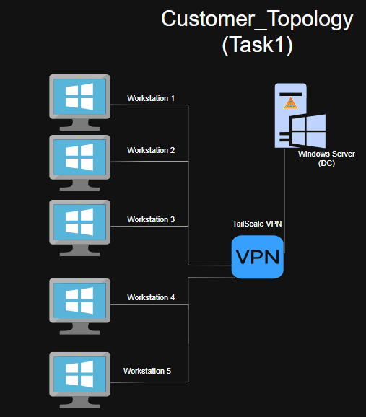
3.Vanguard Architecture
5 Windows workstations (3 on Pc – 2 on Laptop)
1 Windows server (DC) (On Google Cloud)
Active Directory
Tailscale VPN

Slide 8



Log Sources & Collection
On Endpoints:
Windows Security Events
Sysmon
OpenEDR
On Tailscale VPN:
Suricata IDS
Notes:
WSE : Failed logins, privilege escalation, AD abuse
Sysmon : helps in detecting executions and powershell usage (ransomware, malware…)
OpenEDR: Detects malware but also prevents it from running as well. Has Behavior detection also
Suricata : Helps monitoring inbound/outbound traffic into network, monitoring for any C2…

Slide 9
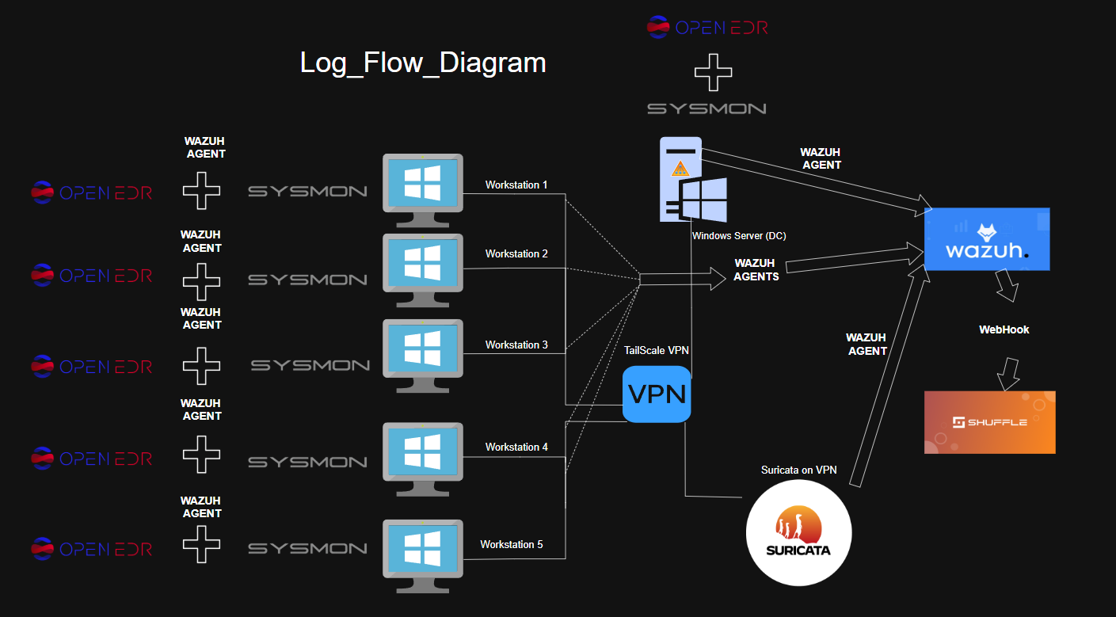
Log Flow

Slide 10
4.Detection Rules
Failed Logon
Group Policy Modification
LSASS Access
Suspicious PowerShell
Shadow Copy Deletion
Notes:
Failed Logon -> Credential and access attacks
GPO Mod - > Privilege escalation and AD DC integrity
LSASS Access -> Credential dumping and lateral movement
Sus PowerShell - > Any malicious or obfuscated executions
Shadow Copy Deletion -> Ransomware attacks

Slide 11
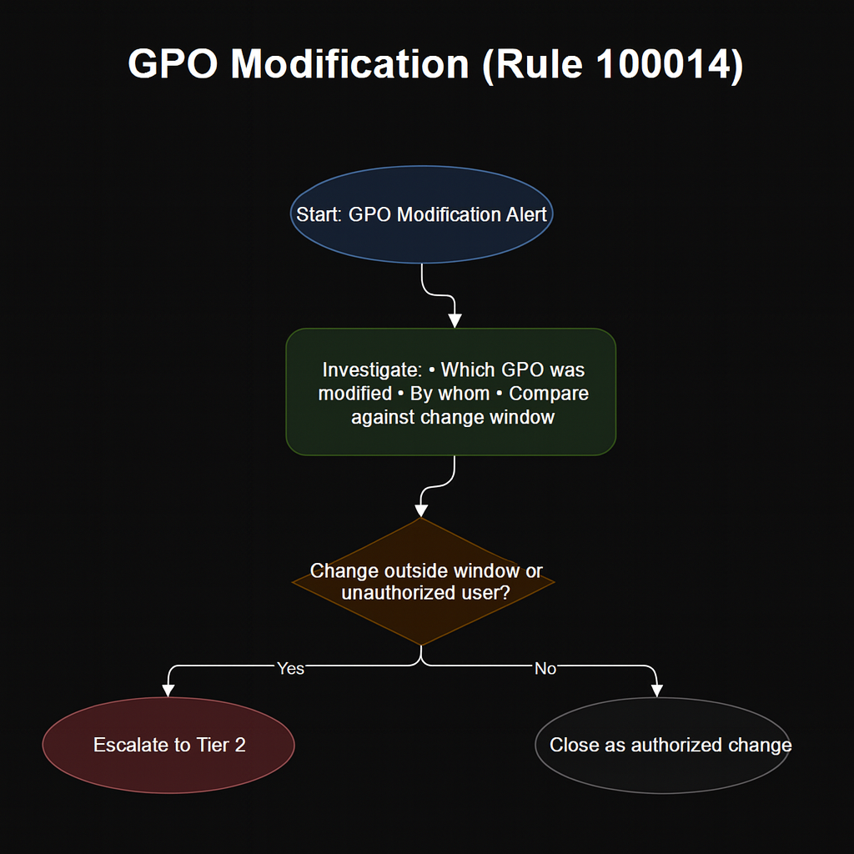
L1 Triage Playbook
Notes:
Compare with other alerts to see maybe we have another alert that a new admin account was suddenly created, so we correlate both alerts to deduce maybe an attack did so and look for : - new admin account
Privilege escalation

Slide 12
SOC Model
Tiered SOC Roles
Alert Prioritization
Standerdized Playbooks
Incident Tracking
Escalation
SOAR Workflows

Slide 13
Shuffle SOAR
Integration with Wazuh
Enrichment
Escalation
Closure Notifications

Slide 14
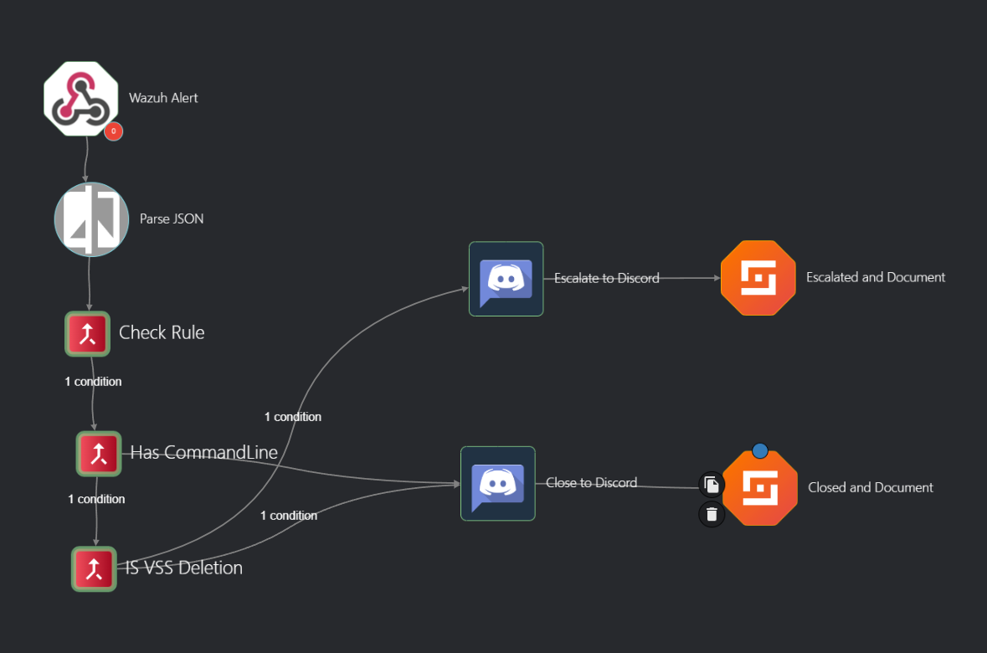
Example Shuffle Playbook: VSS Deletion

Slide 15
Simulation
Wazuh
01
02
03
Attack
Discord
Rule firing in Wazuh with high level (14)
Attempting LSASS access attempt
Alert sent to discord since high level

Slide 16
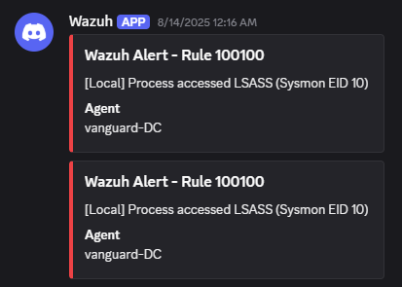
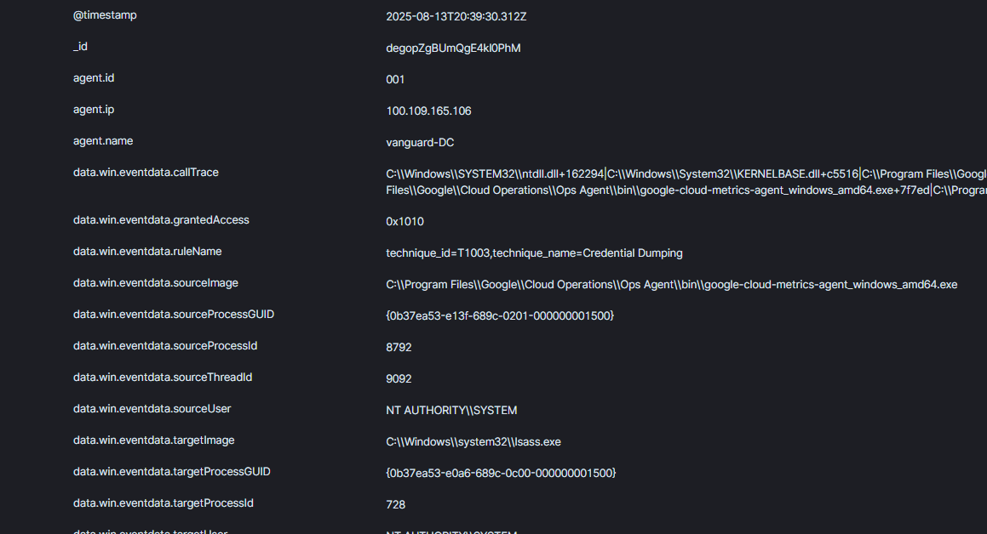
Simulation Wazuh to Discord

Slide 17
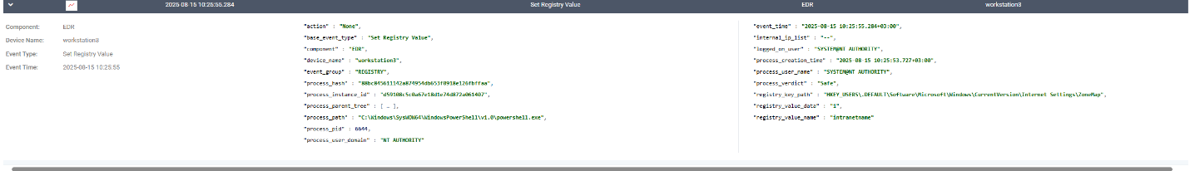
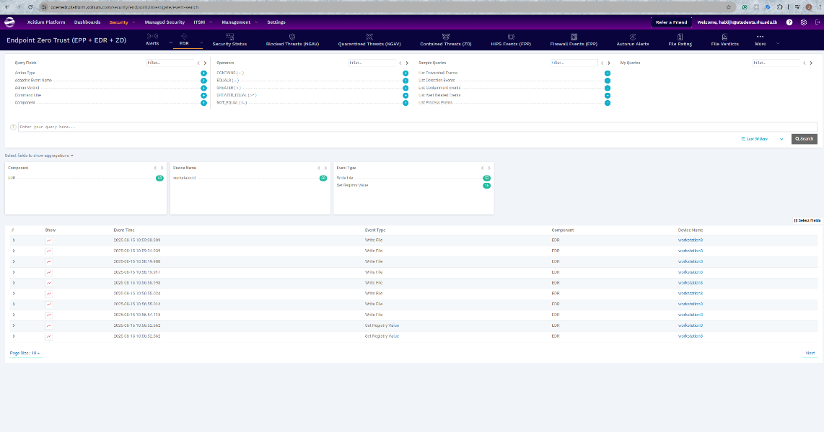
OpenEDR Dashboard

Slide 18
Next Steps
Automate SOAR
Add More Custom Rules & Log Sources
TI Expansion
Migration to Azure AD

Slide 19
Value for Vanguard?
Why?
What is gained?
24/7 monitoring & detection
Built on open-source & scalable tools reducing costs
Defends against external attacks and any inside bribes (ZTA + DiD)
Quicker onboarding than building in house SOC
Improved detection of ransomware
Cost saving
Enhanced client trust
Great for compliance
Can limit bribes
Better reputation
Notes:
Value

Slide 20
Thank You

